Slide 1
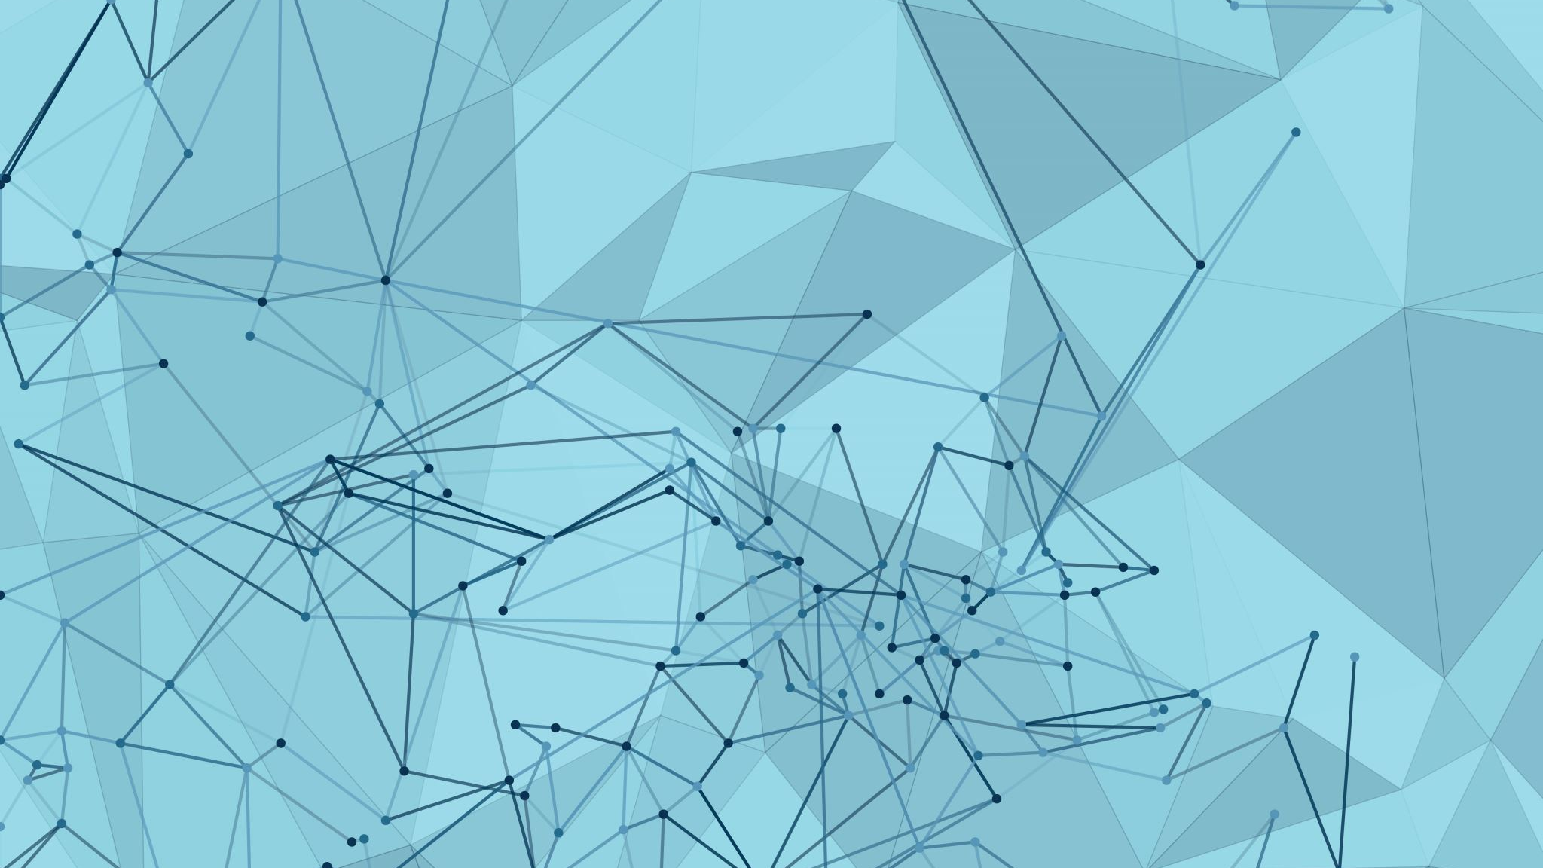
Integrating Face Extraction and ResNet-50 Based Recognition for Accurate Cheetah Identification
Loren Liu, Amanda,
Notes:
We had the chance of meeting in Namibia through a wildlife conservation program supported by National Geographic. This incredible experience deepened our passion for conservation and set us on a path of discovery that has brought us to where we are today.
Back to the presentation, we are excited to present an innovation that has the potential to improve our approach to cheetah conservation.

Slide 2
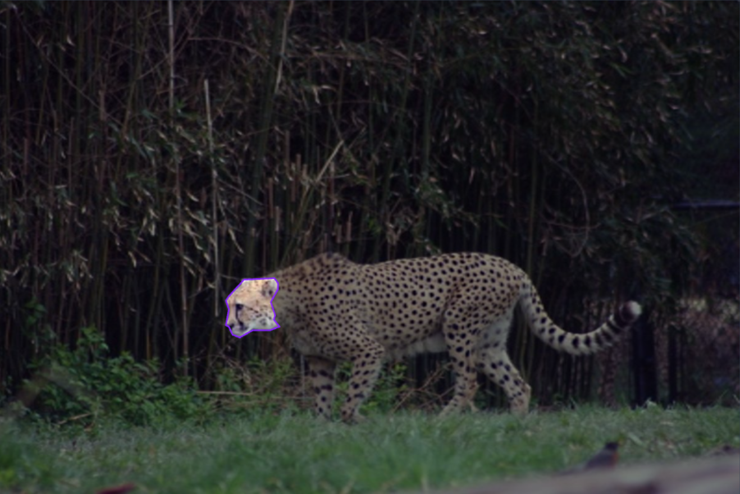
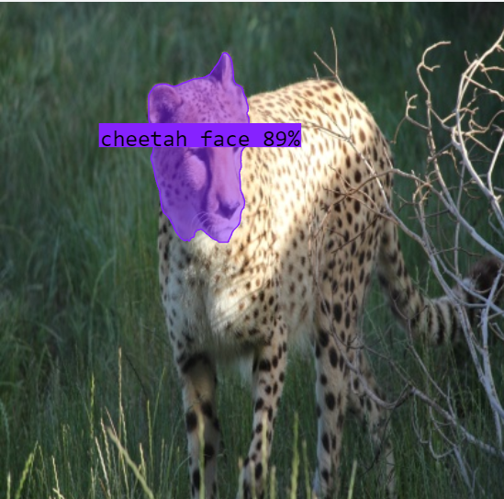
Significance of AI-Powered Facial Recognition
Uses:
Enables non-invasive, ethical individual identification
Accurate, consistent, and long-term data collection and analysis
Enhanced safety and efficiency in large-scale research efforts
Challenges of Facial Recognition
Quality data collection
Differentiating individuals with closely resembling facial features
Technological constraints and biases
Notes:
One primary goal in wildlife conservation is to protect and preserve endangered species while minimizing human interference. With AI-powered facial recognition, we can achieve non-invasive, ethical identification of cheetahs.This means we can monitor and track them without causing them harm or stress.
Furthermore, traditional methods of identifying and tracking cheetahs rely on physical tags or manual observations, which can be error-prone and labor-intensive. AI-powered facial recognition hopes to provide accuracy, consistency, and the ability to collect data over the long term, leading to more reliable insights into the cheetah population.
Now, while the potential benefits of this technology are vast, we must also acknowledge and address the challenges it presents.
main bottlenecks. Environmental factors, lighting conditions, and the cheetahs' behavior can all impact the quality of the images and videos we use for training our AI models.
**Technological Constraints and Biases: ** AI systems can be sensitive biases in training data and may have limitations in their recognition capabilities. It's essential to continuously improve and refine our technology to minimize these biases and constraints.

Slide 3
Previous Applications
LemurFaceID: A face recognition system designed for lemurs, employing a CNN to extract facial features and compare them for identification.
CattleFaceRec: Implementing facial recognition for cattle, aiding in individual animal tracking and management in farms.

Slide 4
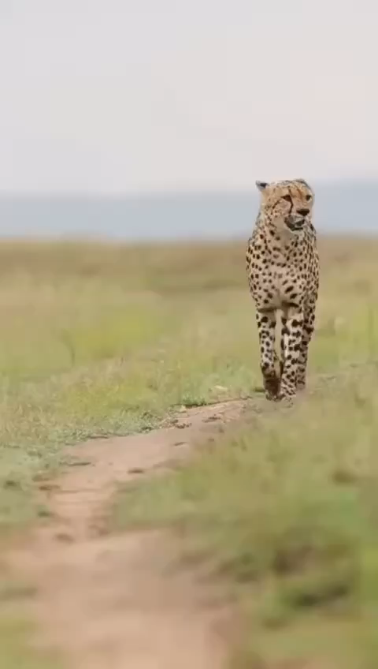
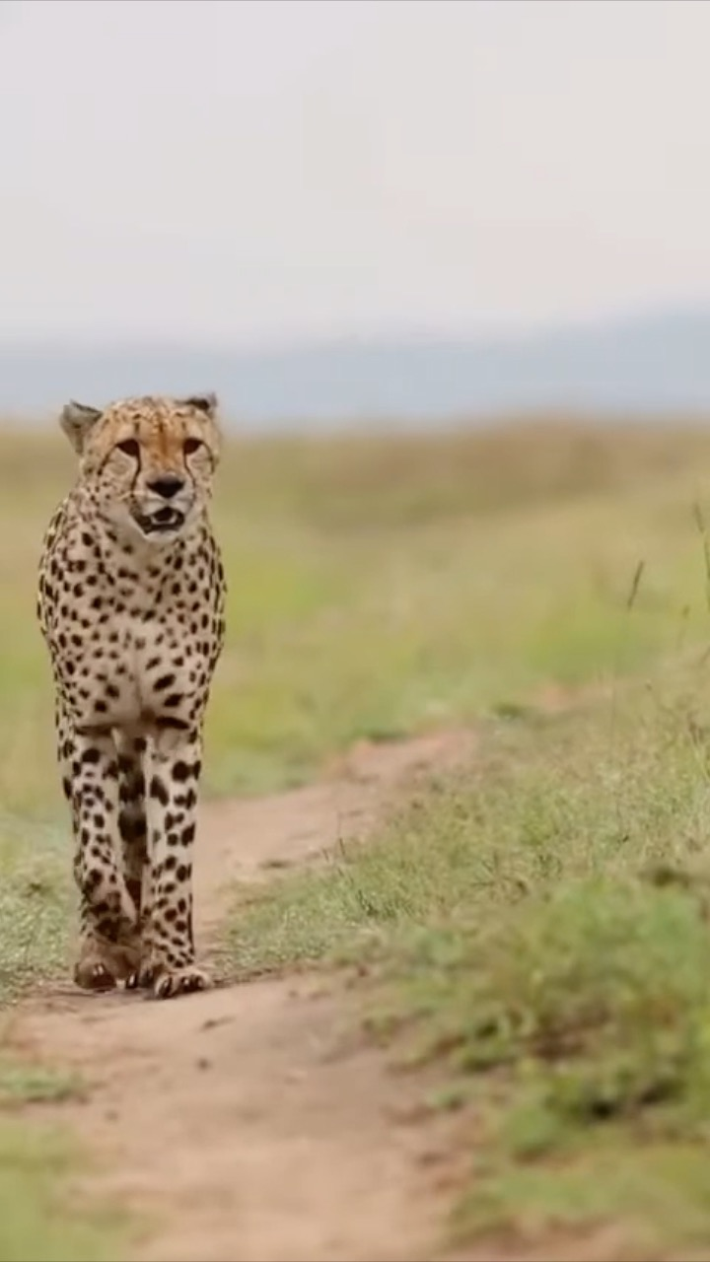
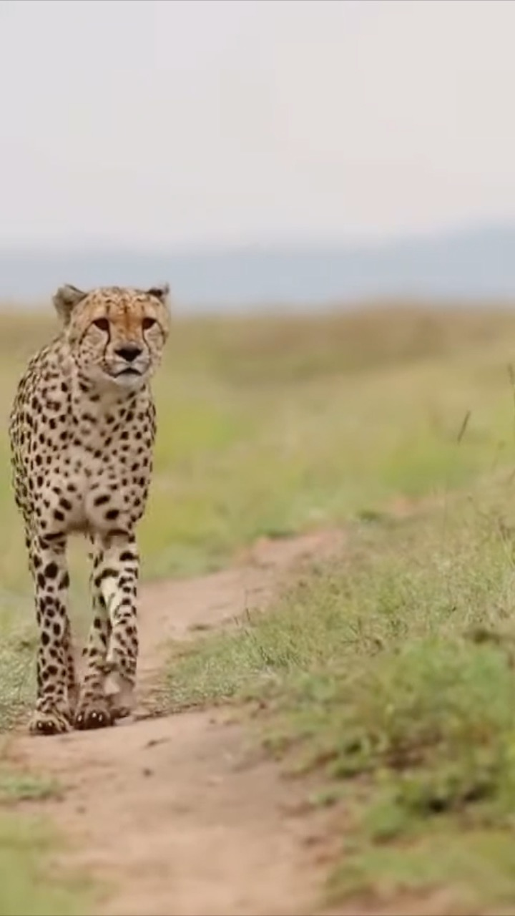
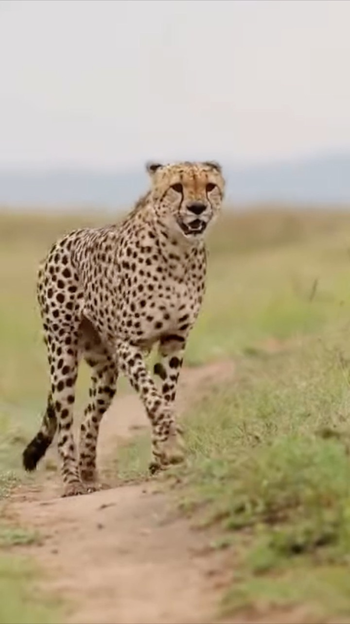
Data
Videos ranging from 3-50 seconds. (One per cheetah)
5 Cheetahs
Source: Wilson Meingati
Notes:
For our project, "PatternPurrfectAI," we drew inspiration from successful implementations like LemurFaceID and CattleFaceRec. We used video data ranging from 3 to 50 seconds, with one video per cheetah, as part of our training dataset. This dataset included information from five distinct cheetah individuals.

Slide 5
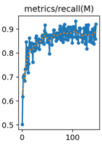
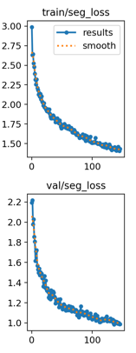
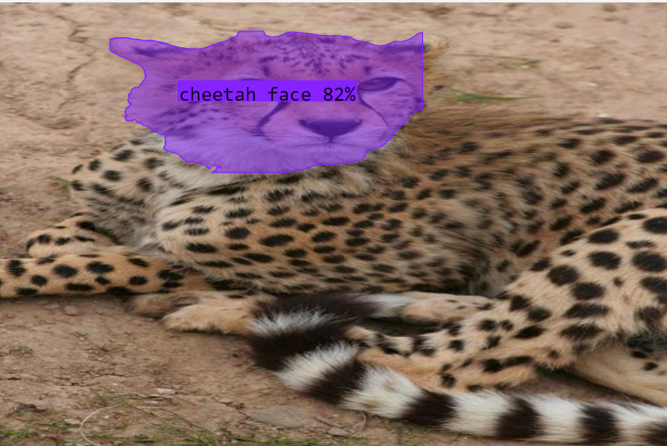
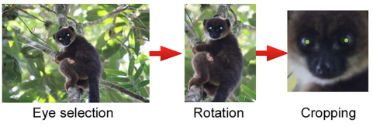
Face Extraction
Trained on Roboflow 3.0 Instance Segmentation
90.3% mAP
Source: Crouse, David, et al

Slide 6
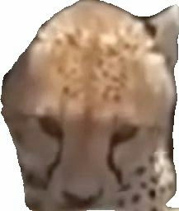
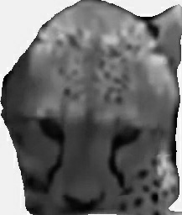
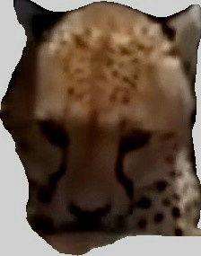
Data Pre-Processing
4x Data Augment
Varying brightness, JPG quality, Saturation, rotation, grayscale (Random)
Resize all images to 100 by 100

Slide 7
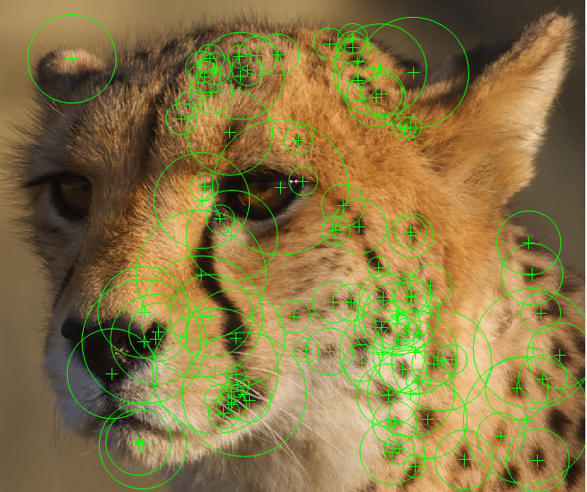
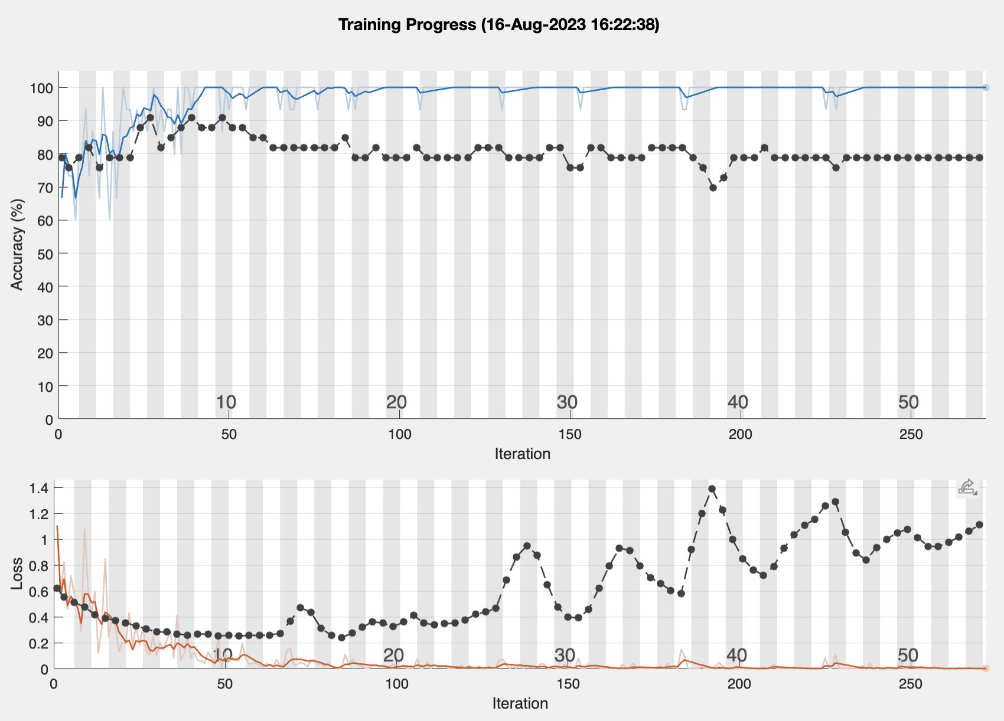
Initial Attempts

Slide 8
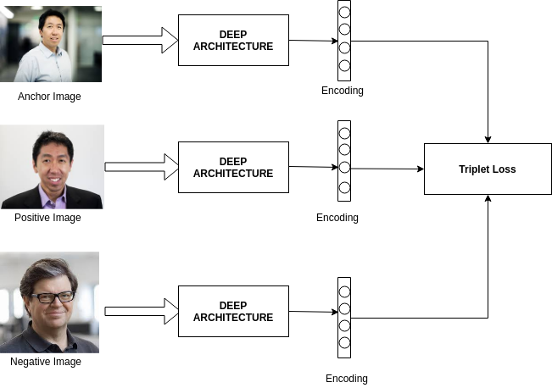
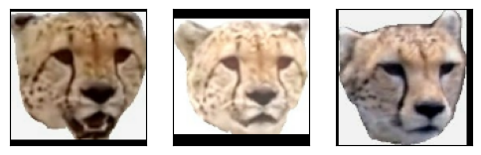
Siamese Neural Network w/ Triplet Loss
Anchor
Positive
Negative
Source: Susmith Reddy

Slide 9
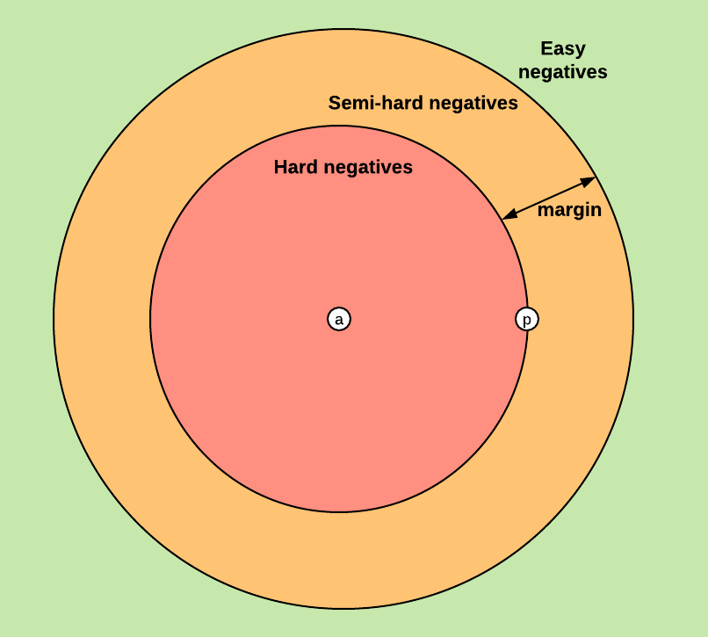
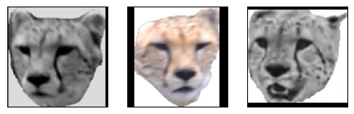
Semi-Hard Batching
Total number of triplet batches with 5 classes: 51,993,126,774 (Around 52 Billion)
-Use Semi-Hard Batching to select best triplets
Source: Enosh Shrestha
Anchor
Positive
Negative

Slide 10
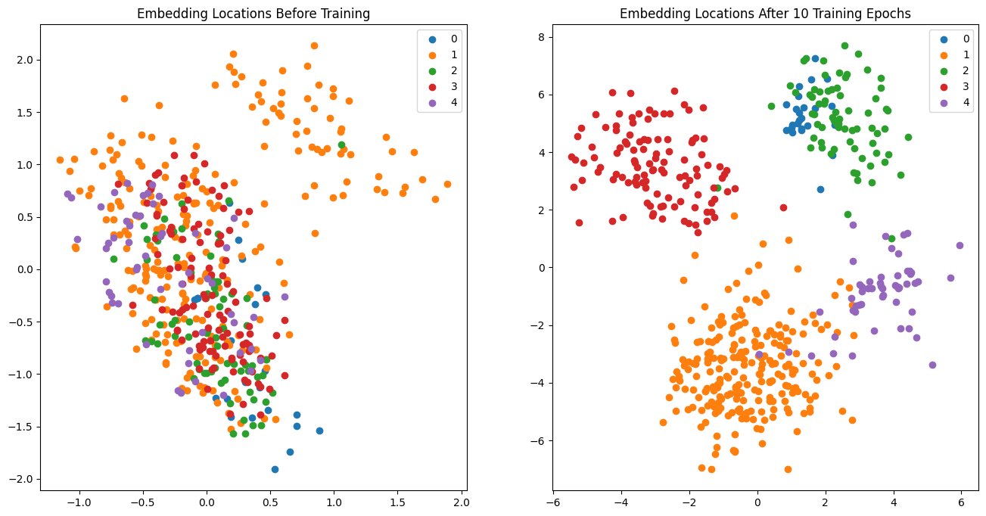
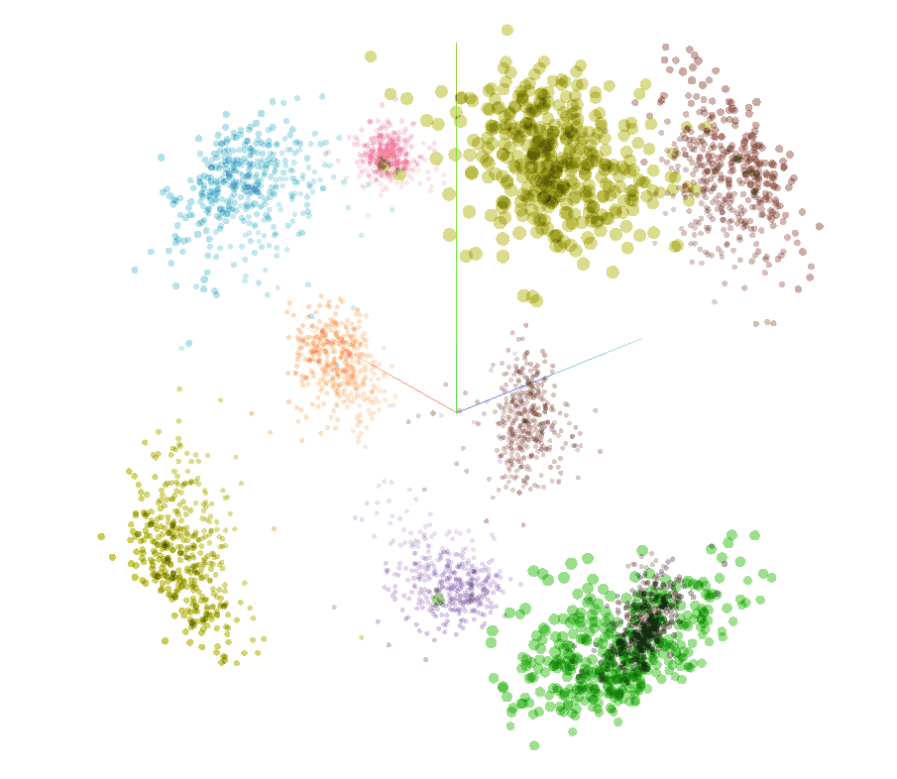
Embedding Space & Demonstration
Source: Enosh Shrestha
Demonstration: PatternPurrfectAI

Slide 11
Future Directions
Field Testing
Expand to other Animals
Test Drone Applications
Notes:
"Field testing is like a real-life exam for our technology. It helps us understand how well our 'PatternPurrfectAI' works in the wild, where things can be unpredictable. We use it to make our technology better and more reliable, so we can protect cheetahs and their homes.

Slide 12


A Special Thanks to…
Dr. Florian Weise
Henrick Cox

Slide 13
Works Cited
1. Reddy, Susmith. "Triplet Loss: A Comprehensive Review." Medium, 12 Jan. 2019, https://medium.com/analytics-vidhya/triplet-loss-b9da35be21b8.
2. Meingati, Wilson. "Cheetah sound it's really amazing 👏." YouTube, https://www.youtube.com/watch?v=YpUsCq5FMXY&ab_channel=WilsonMeingati.
3. Shrestha, Enosh. "Triplet Loss and Siamese Neural Networks." Medium, 24 Oct. 2019, https://medium.com/@enoshshr/triplet-loss-and-siamese-neural-networks-5d363fdeba9b.
4. Crouse, David, et al. "LemurFaceID: a face recognition system to facilitate individual identification of lemurs." BMC Zoology, vol. 2, 2017, https://bmczool.biomedcentral.com/articles/10.1186/s40850-016-0011-9.
5. Xu, Beibei, et al. "CattleFaceNet: A cattle face identification approach based on RetinaFace and ArcFace loss." Computers and Electronics in Agriculture, vol. 193, Feb. 2022, https://www.sciencedirect.com/science/article/pii/S016816992100692X.
6. Zimmermann, Nicole. "The Cheetah." SlidePlayer, https://slideplayer.com/slide/7079861/.

Slide 14
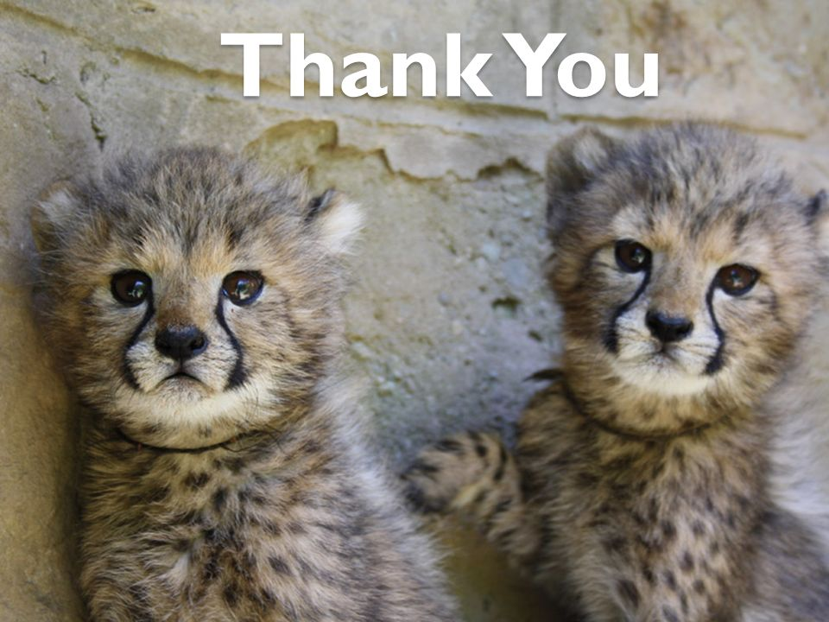
Thank you for your attention!
Source: Nicole Zimmermann

Slide 15
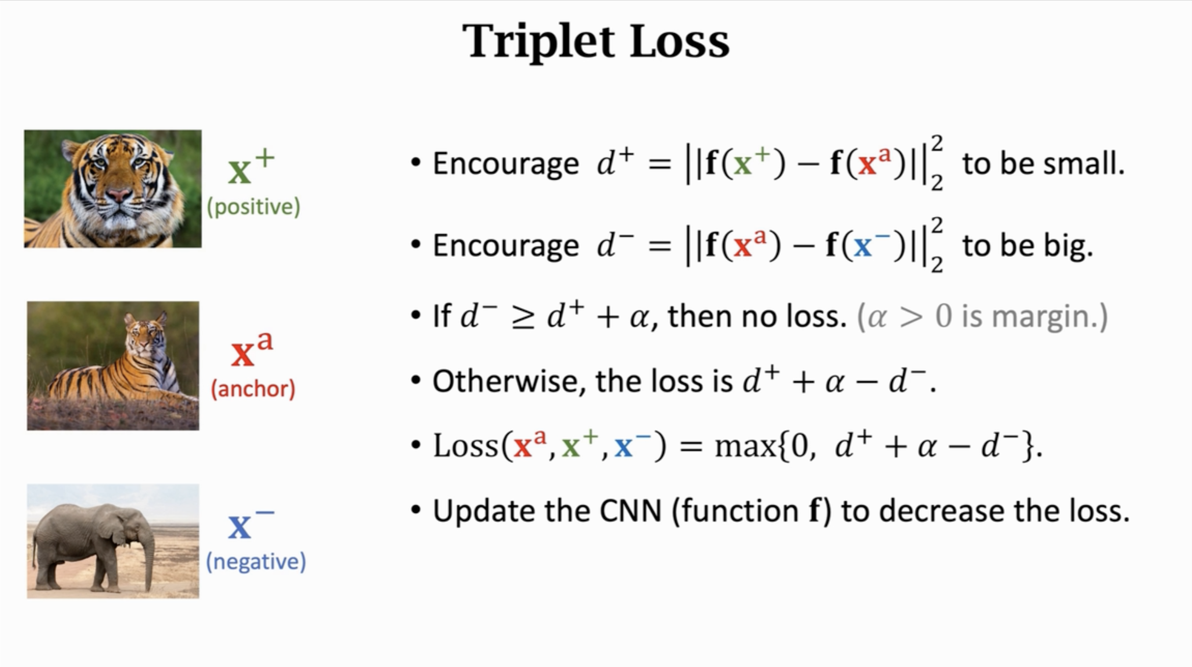
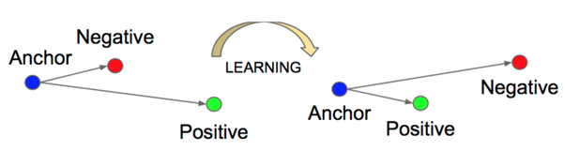
More Detail on Triplet Loss
Great potential of generalization ability

